Slide 1
IE402 OPTIMIZATION PROJECT
MINIMUM COST FLOW PROBLEM
Suyash Bhagat
202101085
B.Tech 2nd Year

Slide 2
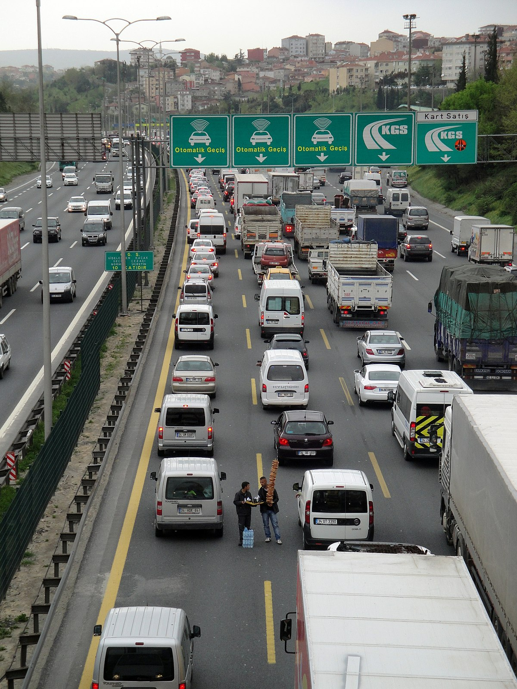
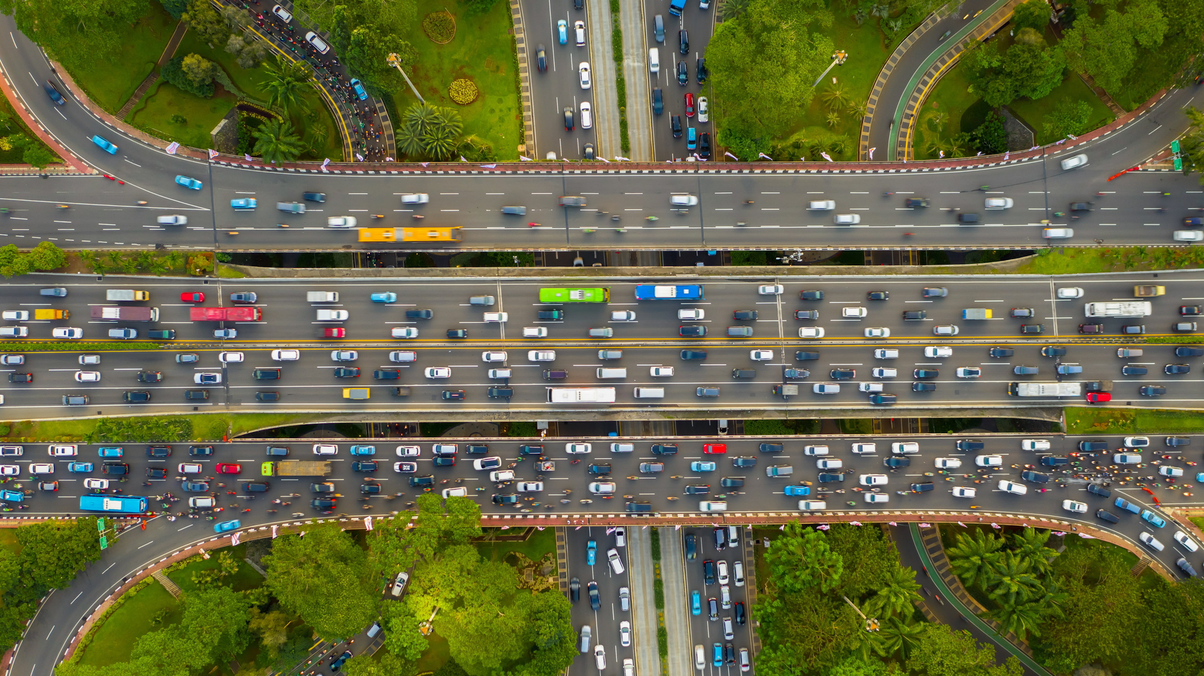
ABSTRACT – Min. cost flow problem
This article describes the Minimum Cost Flow Problem in detail. Considering the scenario of the road map in a city and the traffic on each road as the cost, then using the Min Cost Flow problem we can find a route which has the least traffic. Given a flow network with cost of individual links and outgoing/ingoing flows from a particular node. It shows the method for formulating the LPP for the given network. Then the LPP can be solved using the Simplex Method. In this article, we have used 2-Phase method for solving the LPP. It also gives a brief idea to convert the Min-Cost Flow problem to Min-Cost Max Flow problem.

Slide 3

INTRODUCTION
The Minimum-cost flow problem is a combination of the shortest-path problem and the max-flow problem. The shortest path problem considers the cost in the path and takes which path cost is minimized or in other words selects the shortest path. The max-flow problem tries to maximize the flow in the network without considering the cost of the path. Our problem min-cost flow problem tries to find the path with minimum cost and also maintain the desired flow.
For example:
For graph G, the number of edges is m and the number of vertices is n. Capacity and cost per unit flow of each edge are given. We have to transport the maximum amount of fluid/data from source S to sink T, such that the cost to achieve the maximum flow is minimum. In another variation of problem, supply and demand at each node could be given and we have to satisfy those constraints at minimum cost

Slide 4

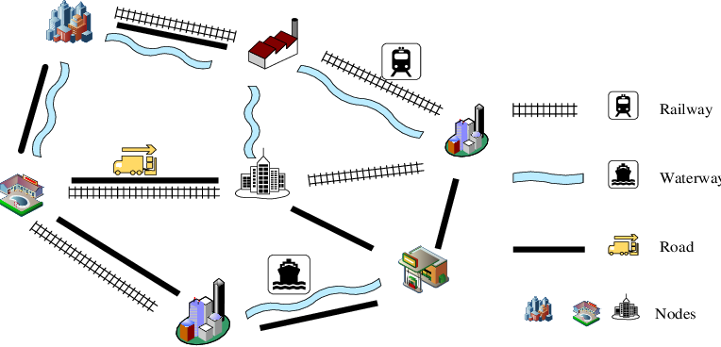
REAL LIFE APPLICATIONS
NETWORK ROUTING:
Consider a network consisting of several routers and several hosts. To increase the speed of data transfer, data packets should be routed optimally. As each router to router link has the capacity and costs a certain amount of time per unit data as per channel medium. Thus we should figure out an optimal routing algorithm.
GOODS TRANSPORT NETWORK:
Consider a goods transport network. Where we want to send goods to the destination as much as we can, there is the cost of transportation by the length of road and time taken.
WATER TRANSPORTATION NETWORK:
Consider a Water Transportation network. Where every pipeline has a limited capacity of water to flow and also cost associated with water per unit. We want to transport maximum water with respect to minimum cost.

Slide 5
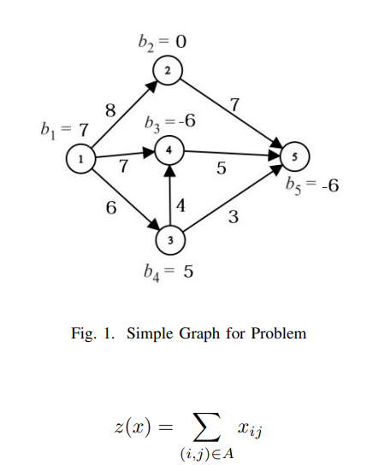
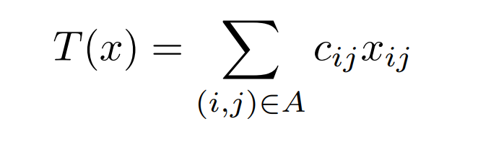
OBJECTIVE OF LOGISTIC CHAIN SUPPLY
The objective of problem supply chain logistics is, to optimize the cost of the logistic supply chain. Respecting capacities, find link flows which balance supply and demand among sources and sinks, with minimum total cost. Each link (i, j) has a specified cost cij and we must determine its flow xij . Each node has a supply bi . If bi > 0, the node is a source(or supply), if bi < 0 it is a sink(or demand), and if bi = 0, it is a transshipment node(or intermediate node). We want to minimize the total transportation cost
For simplicity, assume that if there is a link (i, j), then there is no link in the reverse direction (j, i).

Slide 6
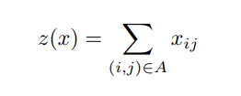

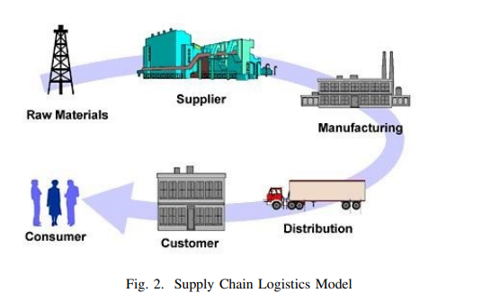
The objective is to minimize:
Such that,
There are three kinds of nodes:
• Manufacturing Plants
• Warehouses
• Retailers
Each manufacturing plant produces a certain quantity of product, which must be shipped first to a warehouse, and then from a warehouse to a retailer which will sell a pre-specified quantity of product.
Our objective is to minimize transportation costs between each plant and warehouse, and between each warehouse and retailer.
These transportation links have a capacity; furthermore, each warehouse has a capacity.

Slide 7
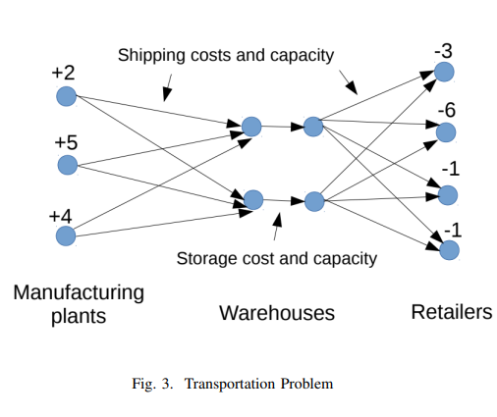

Some assumptions for our objective are,
• All data (cij , bi) are integral.
• The network is directed.
• All costs associated with edges are nonnegative.
The supply/demand at the vertexes satisfy the condition $\sum_{i=0}^{n}{bi}$ = 0 and the minimum cost flow problem has a feasible solution.

Slide 8
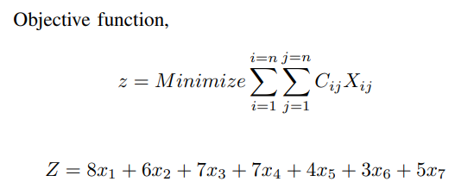
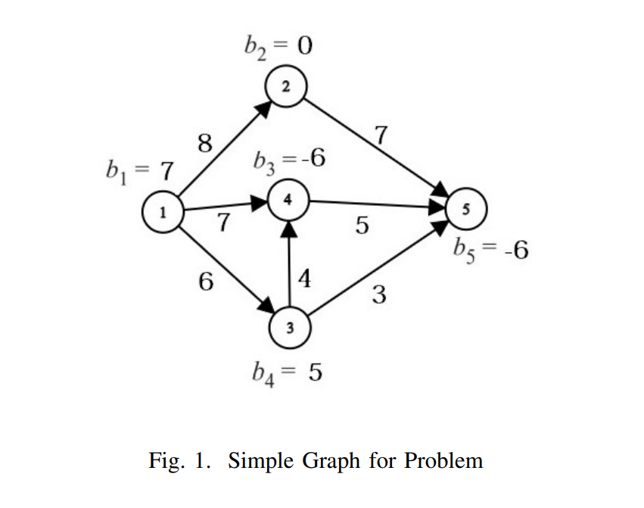
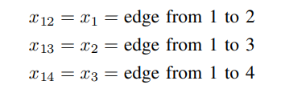
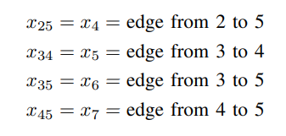
LPP FORMULATION
We are given graph G(V, E) (figure 1), with demand and supply given on each node and cost per unit flow on each edge. Our goal is to minimize the total cost while satisfying the supply and demands of nodes.
In figure 1, positive value of b indicates that is a supply point and negative value indicates demand point. Problem should be balanced, in other words total supply = total demand.
Cij is the cost per unit flow of edge and Xij is the flow in edge between i and j.

Slide 9
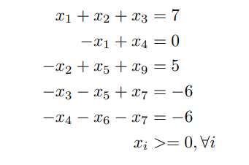
Constraints are as follows: (as per supply and demand conditions and flow of edges)
Thus, above is the LPP formulation which can be solved using simplex method.

Slide 10
Implementation using 2 – phase simplex
After formulating the LPP, the second step is solving it to obtain the optimized solution using any appropriate method. Here we have used a 2-phase method for calculating the solution of the Linear Programming problem.
First, we have introduced the artificial variables in all the constraints, so that we can easily get the initial basic feasible solution. In Phase 1, after getting the initial basic feasible solution we have run a simplex algorithm for cost function with 0 co-efficient for all variables of LPP and (-1) for all artificial variables. In Phase-2, we apply simplex with the original cost function to get the minimum cost.
Considering the below graph for the calculations: For the above given graph, find the minimum value of z,
Z = 8x1 + 6x2 + 7x3 + 7x4 + 4x5 + 3x6 + 5x7

Slide 11
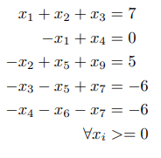
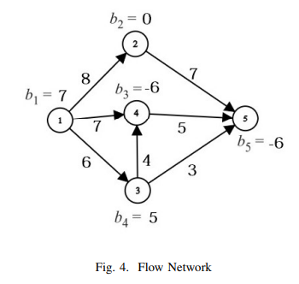
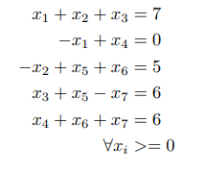
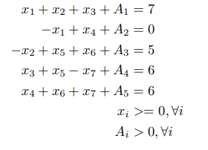
Constraints of above graph are,
The problem is converted to canonical form by adding slack, surplus and artificial variables as required.
Converting above equation into standard LPP by multiply 4 th and 5 th equation by -1,
Now, Introducing artificial variables,
• As the constraint-1 is of type ′ =′ we should add artificial variable A1
• As the constraint-2 is of type ′ =′ we should add artificial variable A2
• As the constraint-3 is of type ′ =′ we should add artificial variable A3
• As the constraint-4 is of type ′ =′ we should add artificial variable A4
• As the constraint-5 is of type ′ =′ we should add artificial variable A5
After adding artificial variables, equations are as follows:
For 2-Phase method,
Z∗ = −A1 − A2 − A3 − A4 − A5

Slide 12
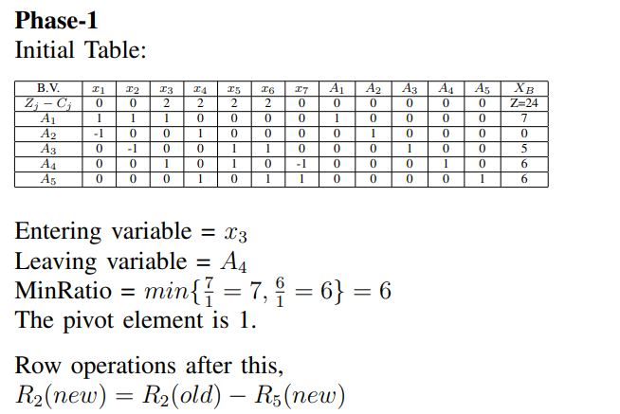

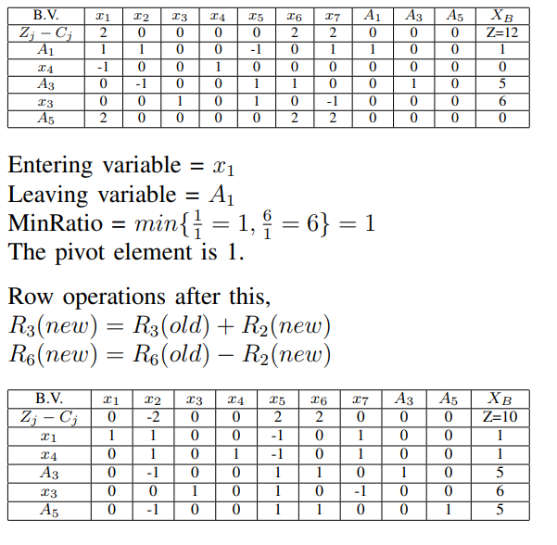
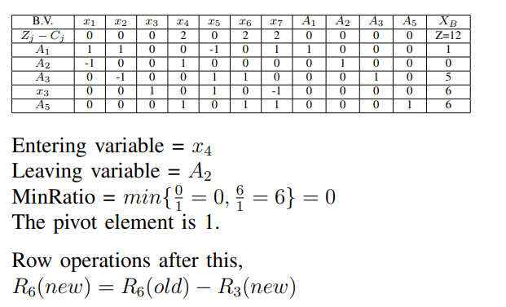
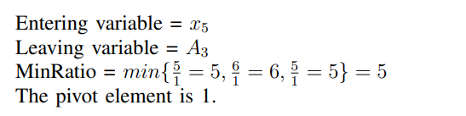

Slide 13
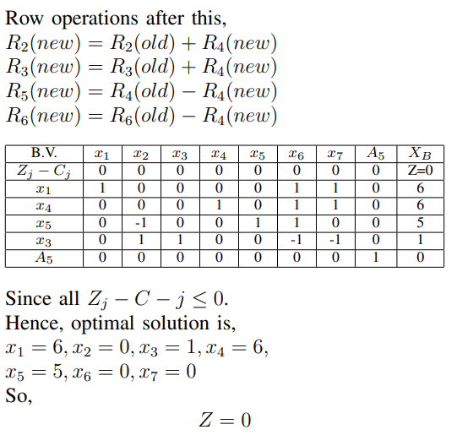
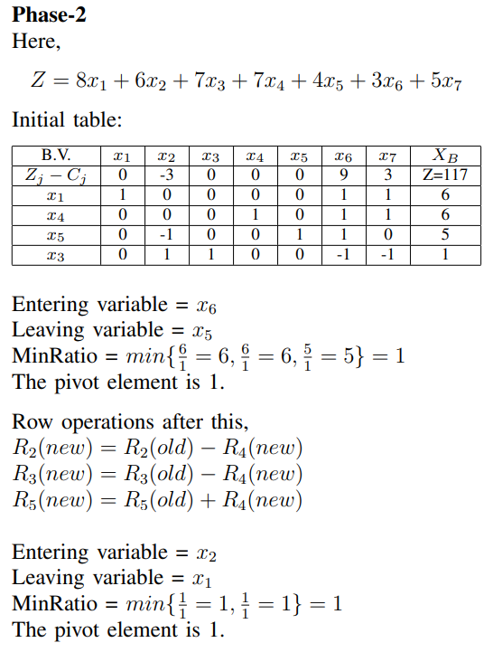


Slide 14
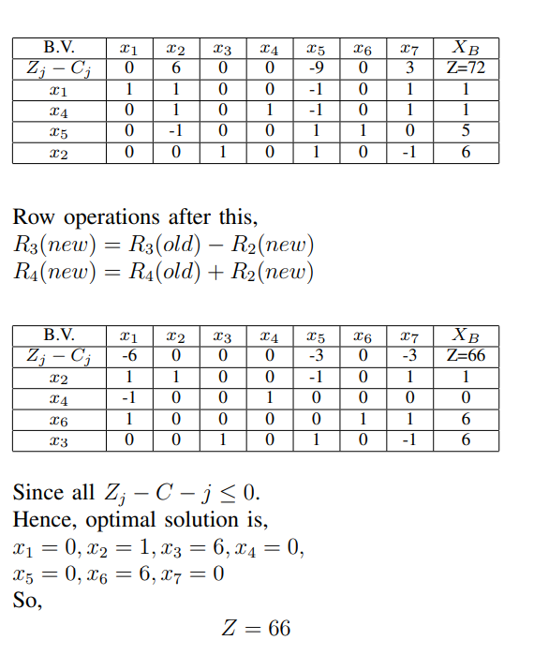

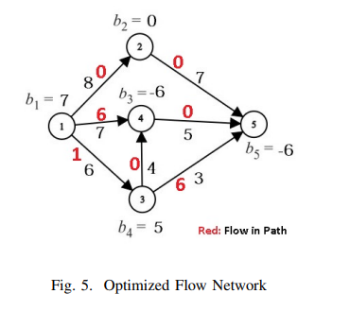

Slide 15

Some important observations
In the above problem, demand and supply at each node was kept fixed. If we remove this constraint then it can be converted to Min Cost Max Flow problem.
In Min Cost Max Flow problem given a source node and sink node, we have to find a path from all the paths having maximum flow from source to sink that gives minimum cost.
In order to obtain Min Cost Max flow problem, we calculate min cost for a particular value of flow. If for a particular flow, the solution does not exist then the algorithm terminates. If there exist a solution then we increase the value of flow as much as possible. If at some instant the flow reaches the desired value or the solution does not exist then we stop iterating further.

Slide 16

conclusion
In this paper, we considered the Min-Cost flow problem on a particular graph.
For Solving the problem, we generated the LPP for the graph. Then we used the 2-Phase Simplex Method to solve the Linear Programming Problem.
The advantage of this method is that it is easy to understand with the help of Simplex tables.
Our computations show that this problem can also be converted into a transportation and transshipment problem. However, we have not discussed those in detail.

Slide 17

acknowledgement
We are thankful to Prof. Manoj Raut for providing us the opportunity to research on such topics and have the experience of applying what we study to real-life scenarios.
Also thankful to TAs for guiding us throughout the semester to carry out our research in the correct direction.

